Slide 1
ABA
Information
Session

Slide 2
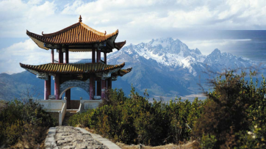
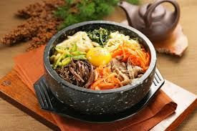
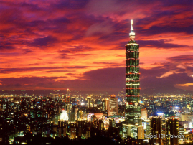
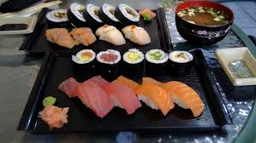
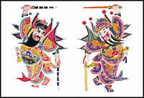
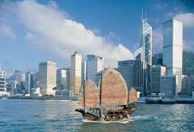
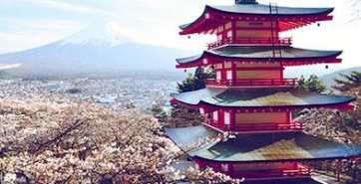
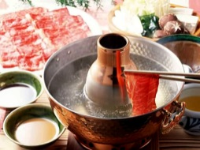
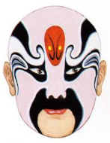
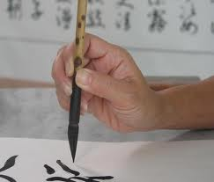
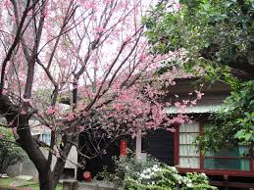
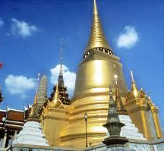
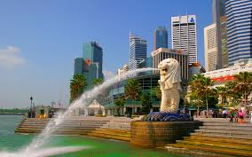
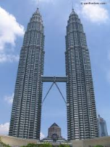
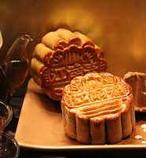
Introduction
Culture
Career
- Alumni Panel
- Trek

Slide 3
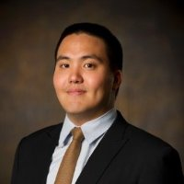
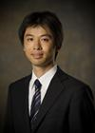
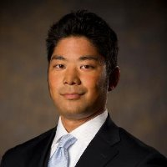
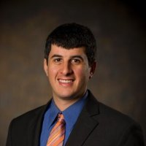
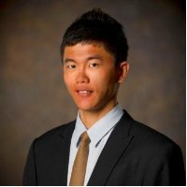
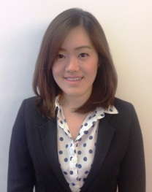
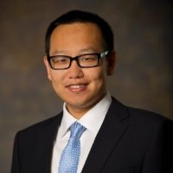
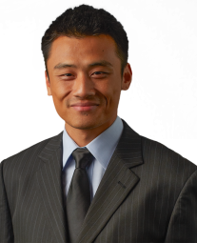
Board members
Jerry Hseih
chseih@
President
Masuki Kuroda
masukik@
Finance Officer
Andy Sugino
asugino@
VP of External Relationship
Zachary Colman
zcolman@
VP of Marketing
Andy Chen
kuanweic@
VP of Career Development
Watcharee Anantasabkit
wanantas@
VP of Event
Mark Qiao
tqiao@
VP of Event
Ken Wang
xiankaiw@
MSCF Representative

Slide 4
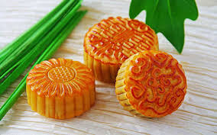
Events in MINI 1
Event | When | Description
Internship Recruiting Panel / Info Session | Sept, 25th | Sharing internship experience and tips for international students
Mid-Autumn Festival | Oct (1st week) | Celebration and cultural learning
Boston Career Forum | Oct (2nd week) | ABA only
Sports Tournament | Oct (3rd week) | Ping-Pong or Badminton

Slide 5
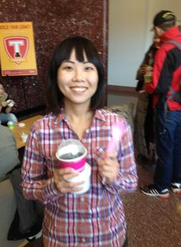
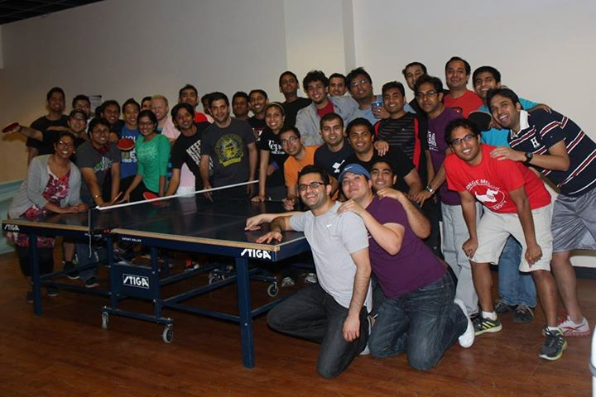
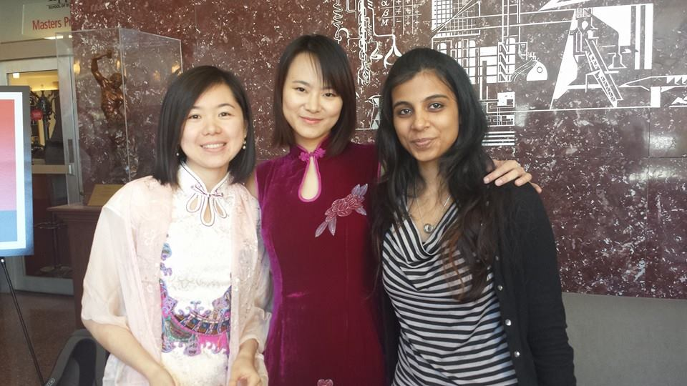
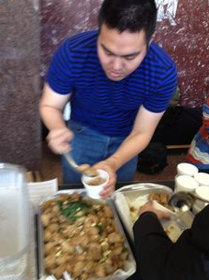
Events in MINI 2
Event | When | Description
Asian Month | Nov (1st week – 4th week) | Cultural learning (China, Japan, Thailand, and Taiwan)
Hong Kong Recruiting Trek | Nov (3rd week) | ABA members only
ABA Trek Info Session I | Dec (4th week) | Information on visiting plan

Slide 6
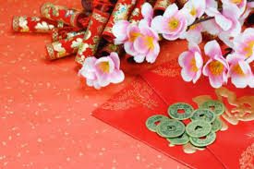
Events in MINI 3
Event | When | Description
ABA Board Election | Jan (3rd week) | ABA only
Lunar New Year Party | Feb (1st week) | Celebration and cultural learning

Slide 7
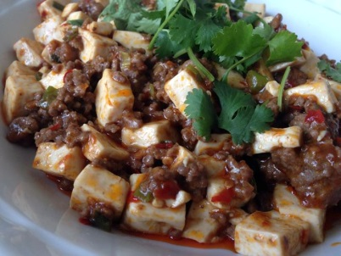
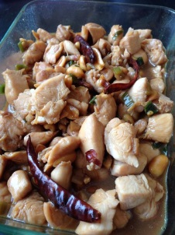
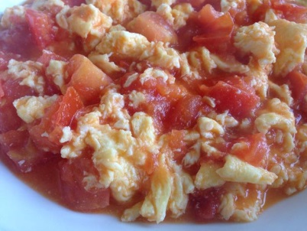
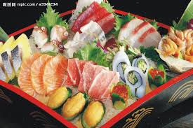
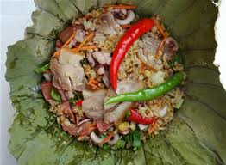
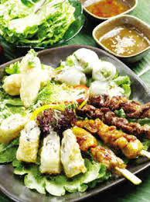
Events in MINI 4
Event | When | Description
International Festival | Apr | Cultural learning
Cherry Blossom Trip to DC | Apr | Memorable event to enjoy natural beauty
Asian Food Making | Apr | Cooking tips
Reunion Week | Apr | ABA only
Appreciation Party | Apr | ABA only

Slide 8
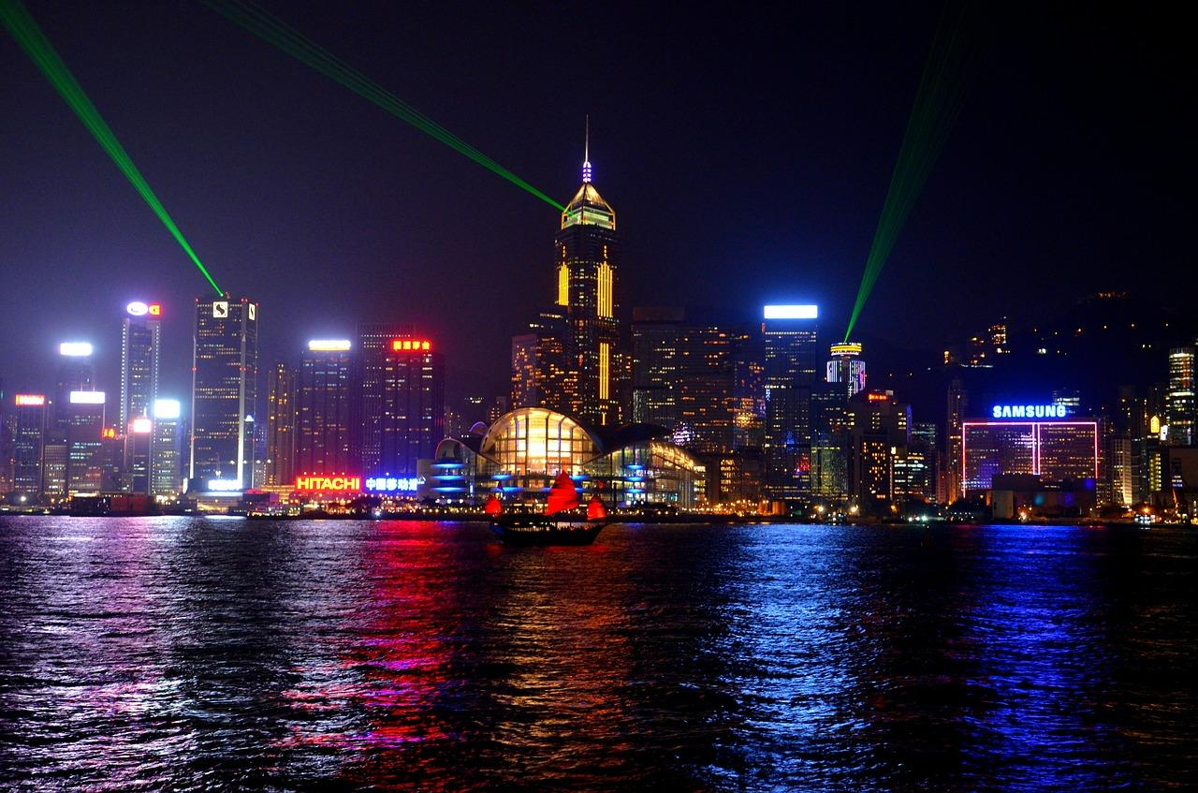
Hong Kong Trek

Slide 9
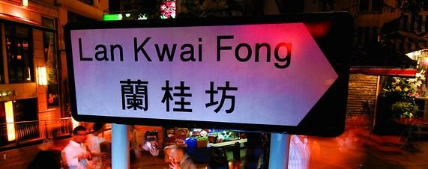
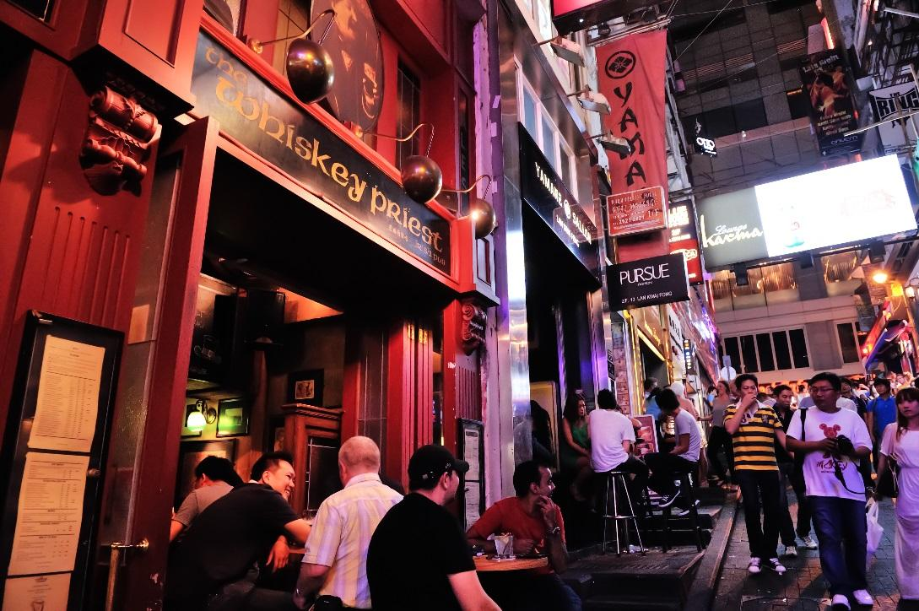
Hong Kong Trek (Alumni Event)
When: 11/24-11/28 (Thanksgiving)
Free food and drinks!

Slide 10
Alumni Event (CMU Campus)
When: 11/7/2014 12:00~13:00
Free food but no drinks!

Slide 11
Mentorship
If you are:
Overwhelmed by the career options
Shy in the crowd
Don’t know what to do in Tepper
Knowing too many things to do in Tepper but can’t prioritize

Slide 12
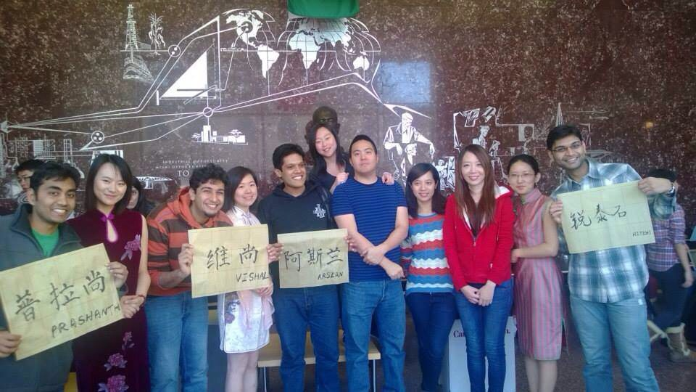
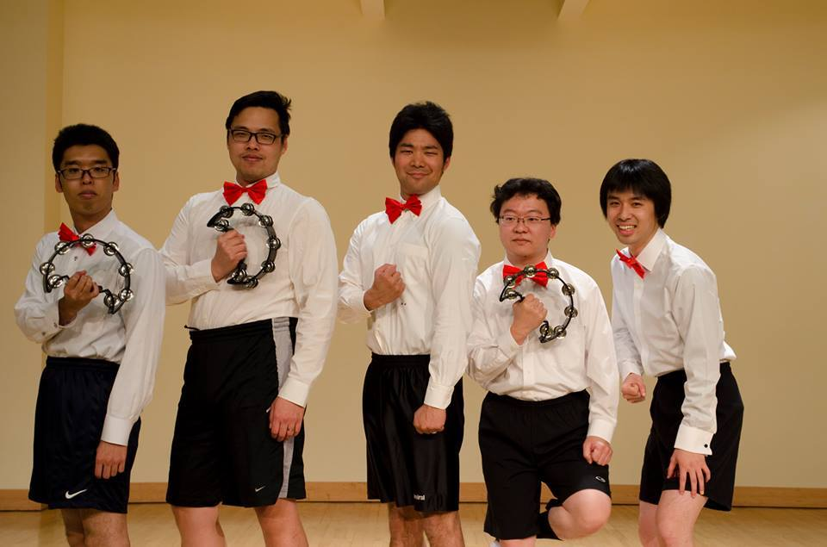
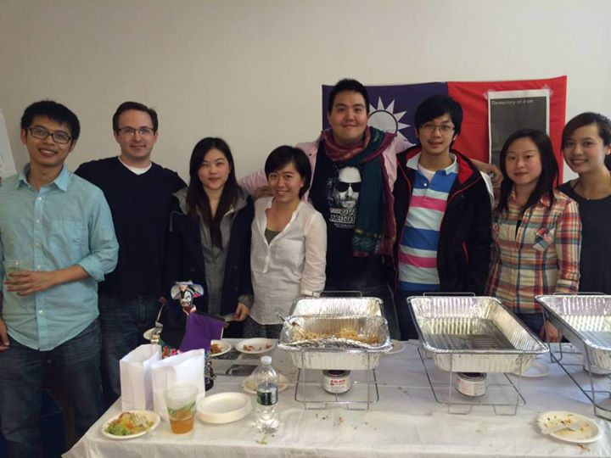
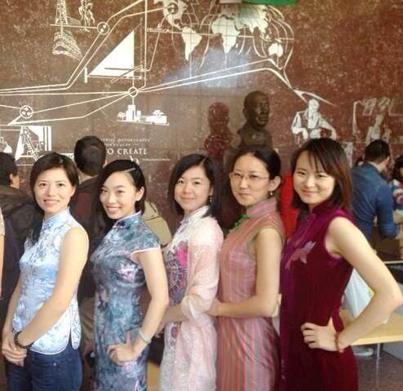
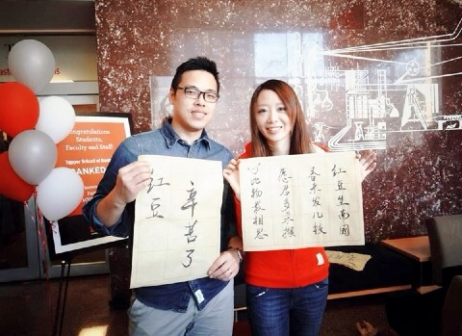
International Festival and Culture Week

Slide 13
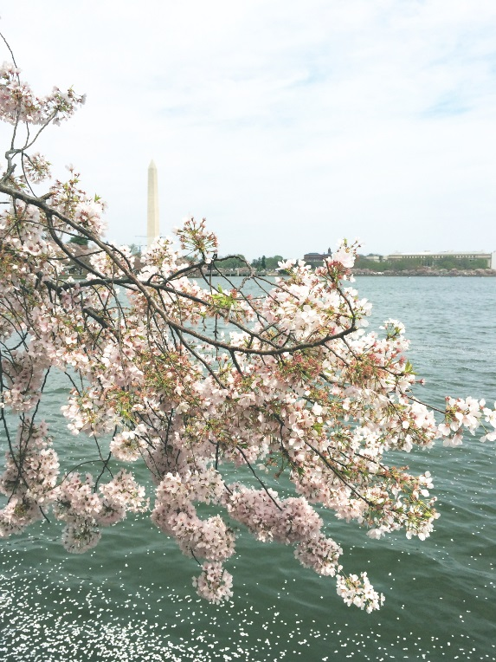
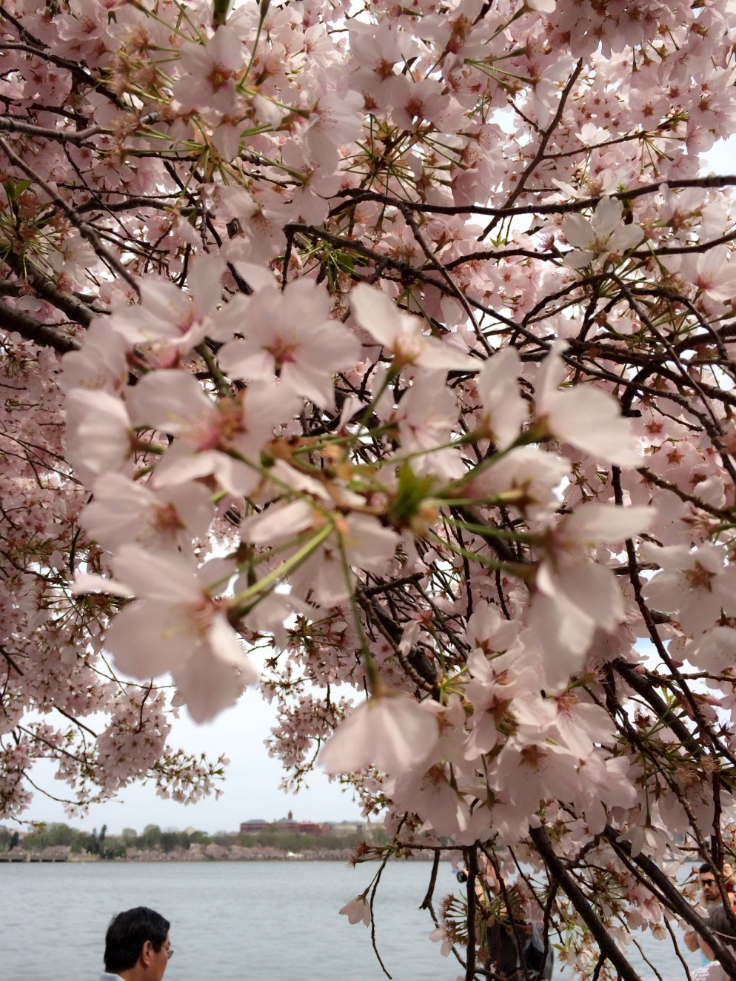
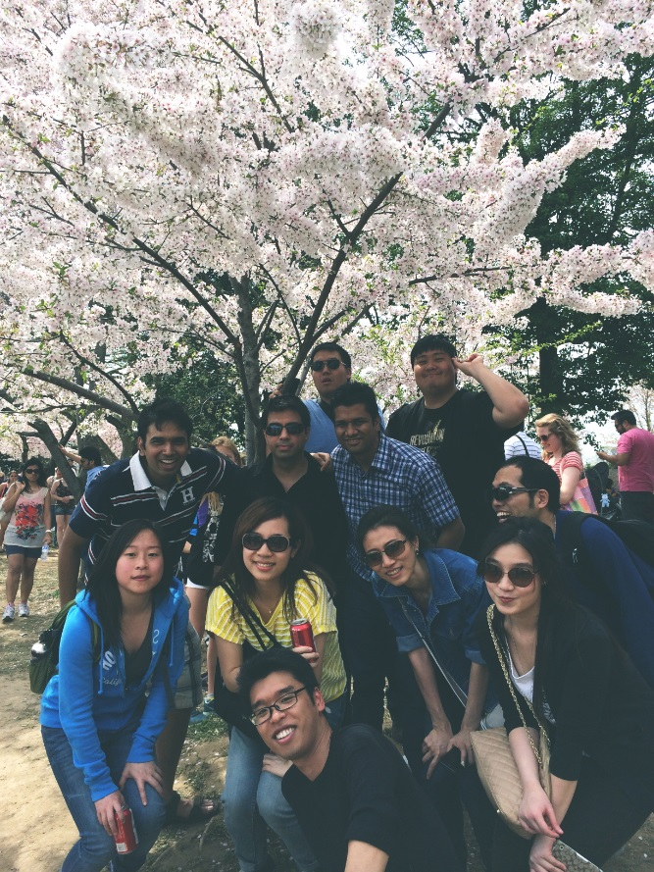
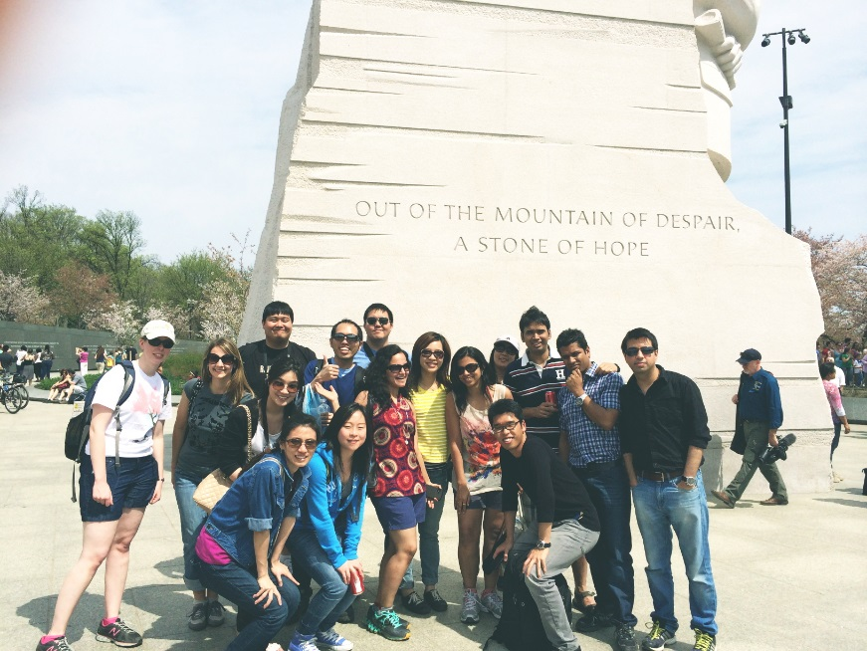
Cherry Blossom Trip to DC

Slide 14
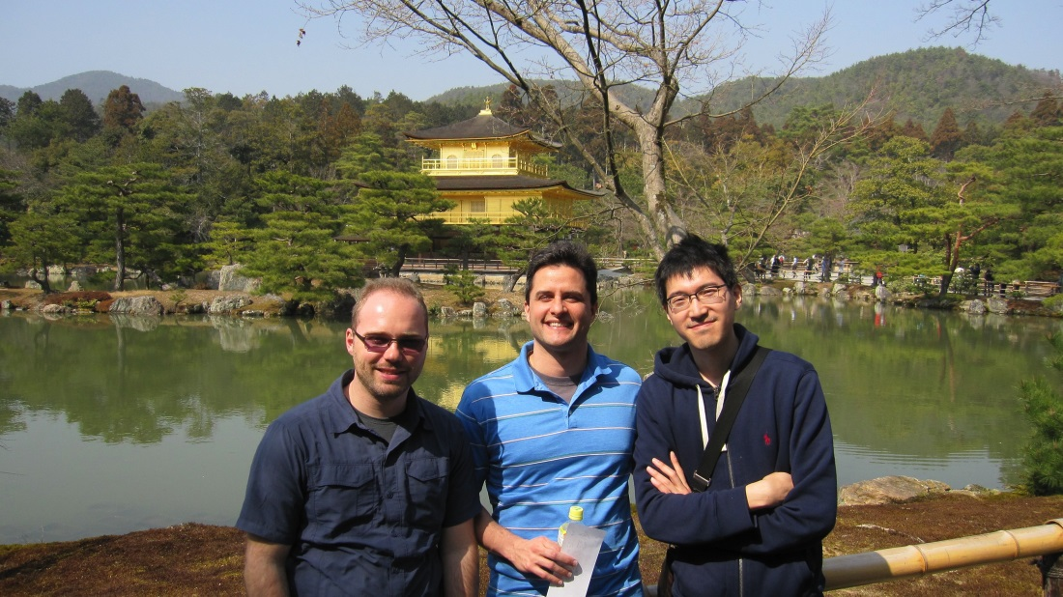
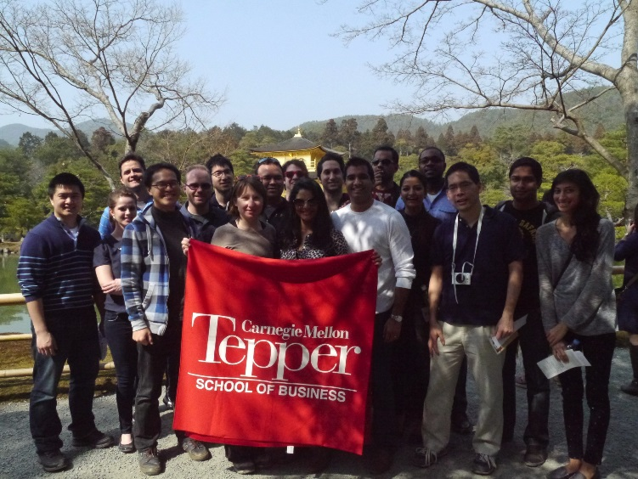
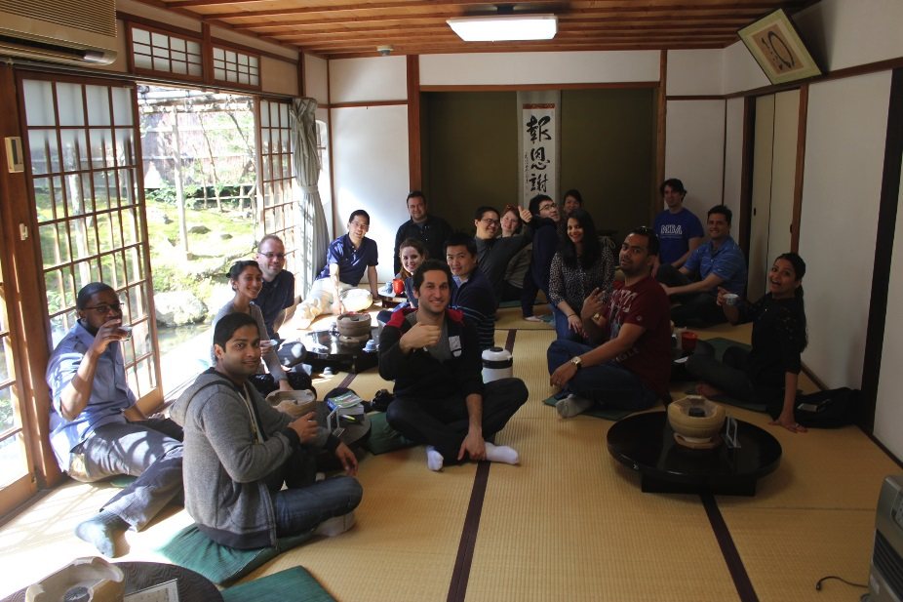
Japan Trek

Slide 15
Contact us
Tepper Asian Business Association facebook
https://www.facebook.com/groups/558626690821454/
Campus Group
https://tepper.campusgroups.com/student_community?club_id=10948

Slide 16
Membership fee
2 years membership: $60
1 year membership: $40
MSCF membership: $50

Slide 17
Next event…
Internship Recruiting Panel / Info Session
September, 25th

Slide 18
JOIN US TODAY!
JOIN US TODAY!

Slide 19
ASIAN GUIDE
IN
PITTSBURGH

Slide 20
WELCOME TO PITTSBURGH !!

Slide 21
EATING IN PITTSBURGH

Slide 22
ROSE TEA CAFE – Taiwanese food
5874 ½ Forbes Ave
(412)-421-2238

Slide 23
EVERYDAY NOODLES – Chinese food
5875 Forbes Ave
(412)-421-6668
(412)-421-6669

Slide 24
HUNAN BAR – Chinese food (HOT POT)
239 Atwood Street
(412)-621-2326

Slide 25
I TEA CAFÉ – Taiwanese food (Hot Pot)
709 Bellefonte Street
(412)-688-8330

Slide 26
SICHUAN GOURMET – Chinese food
1900 Murray Ave
(412)-521-1313

Slide 27
CHAYA – Japanese food
2032 Murray Ave
(412)-422-2082

Slide 28
RAMEN BAR – Japanese food
5860 Forbes Ave
(412)-521-5138

Slide 29
GREEN PEPPER– Korean food
2020 Murray Ave
(412)-422-2277

Slide 30
BANGKOK BALCONY – Thai food
5846 Forbes Ave
(412)-521-0728

Slide 31
Noodlehead – Thai food
242 S Highland Ave
(412)-521-0728

Slide 32
Tram’s Kitchen – Vietnamese food
4050 Penn Ave
(412)-682-2688

Slide 33
SHOPPING IN PITTSBURGH

Slide 34
LOTUS FOOD COMPANY – Chinese Market
1649 Penn Ave
(412)-281-3050

Slide 35
MANY MORE – Chinese Market
3050 Smallman Street
(412)-471-0900

Slide 36
TOKYO JAPANESE FOOD STORE
5855 Ellsworth Ave
(412)-661-3777

Slide 37
SEOUL MART – Korean Market
4701 Fifth Ave
(412)-622-7313

Slide 38
MALL & OUTLETS

Slide 39
ROSS PARK MALL
1000 Ross Park Mall Dr.
(412)-369-4400

Slide 40
THE MALL AT ROBINSON
100 Robinson Centre Dr.
(412)-788-0816

Slide 41
TANGER OUTLETS
2200 Tanger Blvd, Washington PA
(724)-225-8435

Slide 42
GROVE CITY PREMIUM OUTLETS
1911 Leesburg Grove City Road,
Grove City, PA (724)-748-3875

Slide 43
SINGING IN PITTSBURGH

Slide 44
KBOX karaoke
214 S Craig Street
412-621-2860
www.kbktv.com

Slide 45
TRAVELING IN PITTSBURGH

Slide 46
CARNEGIE MUSEUMS
1.Carnegie Science Museum
2+3. Carnegie Museum of Art and Natural History
4.Andy Warhol Museum

Slide 47
SPORTS
5.PNC PARK (PIRATES) - BASEBALL
6.HEINZ FIELD (STEELERS) - FOOTBALL
7.CONSOL ENERGY CENTER (PENGUINS) - HOCKEY

Slide 48
AROUND SCHOOL
8.CATHEDRAL OF LEARNING
9.MELLON INSTITUTE
10.CARNEGIE LIBRARY OF PITTSBURGH

Slide 49
ZOO, AQUARIUM, CONSERVATORY
11.PHIPPS CONSERVATORY
12. ZOO AND PPG AQUARIUM

Slide 50
DOWNTOWN
13.PPG PLACE
14.POINT PARK
15.BENEDUM CENTER
16.OLD JAIL/COURT HOUSE

Slide 51
MOUNT WASHINGTON
17.STATION SQUARE
18.FORT PITT BRIDGE
19.MONONGAHELA INCLINE
20.DUQUESNE INCLINE

Slide 52
OTHERS
21. RIVERS CASINO
22.SCHENLEY PARK
23.KENNYWOOD AMUSEMENT PARK

Slide 53
OTHERS
FALLING WATER
OHIOPYLE STATE PARK

Slide 54
OTHERS
KAYAK
Venture Outdoors
33 Terminal Way, #537
PAINTBALL
Three Rivers Paintball and Airsoft
282 Rochester Rd, Freedom, PA

Slide 55
OTHERS
ICESKATE
The Rink at PPG Place or
Schenely Park Skating Rink
SKI & SNOWBOARD
Boyce Park Ski & Snow Tubing Area
675 Old Frankstown Rd

