Slide 1
First Time Home Buying Series
Financing

Slide 2
Table of Contents
Determining your budget
Selecting your loan
Bank approval process
Mortgages
Tax shields

Slide 3
Timeline of a Loan Application
Application
Pre-approval
Loan Originator
Lender documents
Loan processor

Slide 4
Mortgage Lender
Relevant Questions:
Types of loan do you offer?
Payment schedules are available?
Current interest rate for 30-yr fixed?
Application fees?
Premium/Points/Private Mortgage Insurance?

Slide 5
Mortgage Broker v/s Bank
Broker
Middle Man
Shop Around
Save time & Irritation
Brokers handle Paperwork
Only one credit report
Banks
Banks are lending
More decision power
Good Relationship
Jumbo loans
Multiple credit report

Slide 6
Before Pre-Approval
Stable Income
Good Credit History
Down Payment
Documentation
Debt-to-income
ratio 36%
Payment to income ratio 28% or 33%
Notes:
Car loans, Personal loans , line of credit, Credit Cards, Student loans, other loans.

Slide 7
Documentation for loans.
Paycheck stubs, W-2’s
SSN or Tax Identification number
Bank Statements- 3 Months
Tax Return 2 years
Evidence of other income
Balance sheet & Income Stmt- Self Employed
Employment Verification
Gift Letter

Slide 8
What if I am not Pre Approved ?
Correct errors on Credit Report
Decree overall debt
Increases down payment

Slide 9
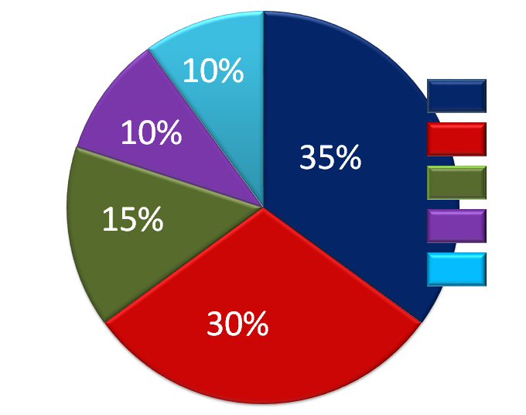
FICO Score
Notes:
> 750 Excellent
721-749 Good
660-720 Average
620-659 Fair
< 619 Poor

Slide 10
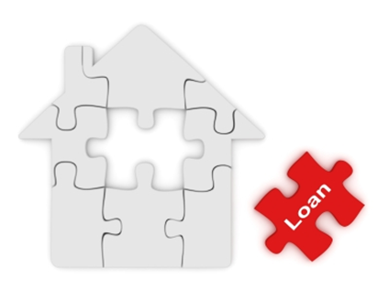
Why do I need a Pre-Approval ?
•Amount you can borrow
•Bargaining power
•Close quicker
•Discover issues early
•Establish best loan
•Look at the “Right” homes
Notes:
24 to 48 hous

Slide 11
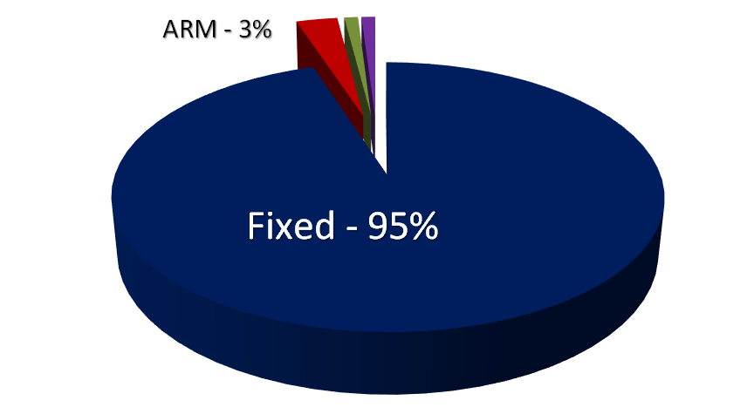
Types of Mortgages
Fixed Rate Mortgage
Adjustable Rate
FHA Loans
VA loans-
Balloon Mortgages
Jumbo Loans
Notes:
SEE EXCEL
FHA- Federally insured, Insured , Low scores, 3.5% down, conditions,
Veterans, 103% financing, no PMI

Slide 12
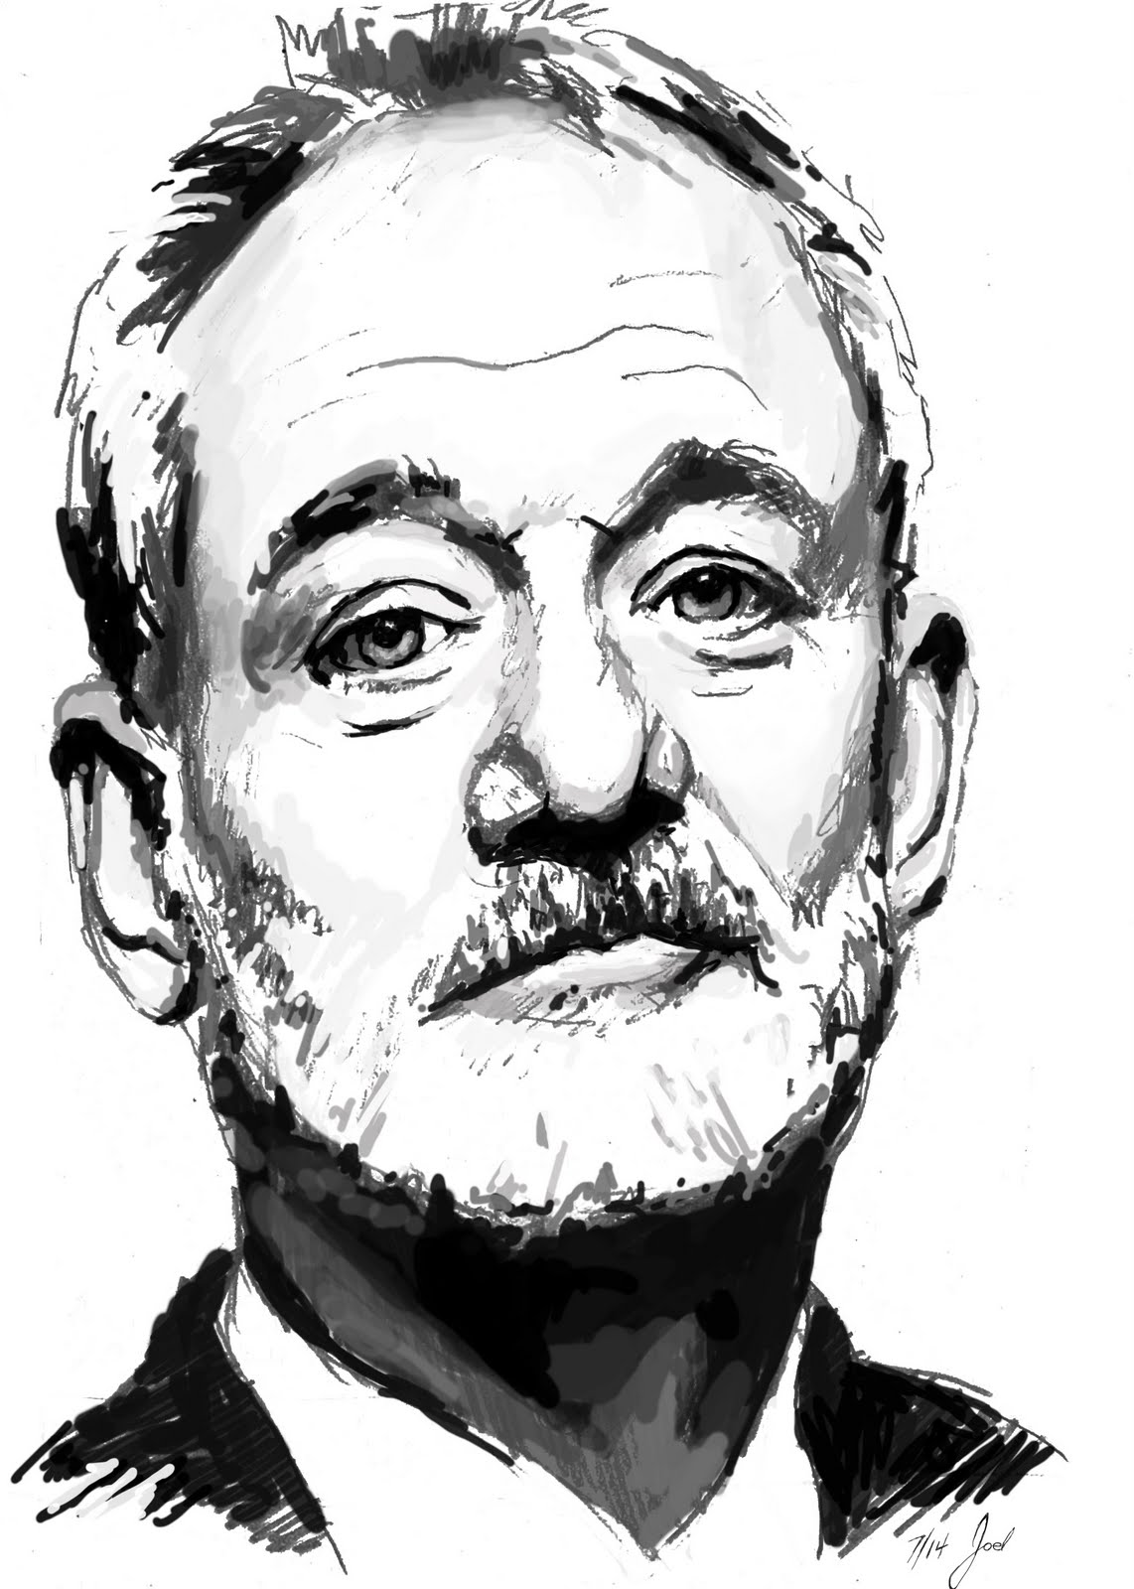
The 5 C’s of Credit
Character - Your credit worthiness is based on your stability and net worth.
Capacity - Are you able to cover your current debts along with the added expense of owning your own home?

Slide 13
The 5 C’s of Credit
Credit - A good credit history demonstrates your ability to repay an outstanding debt
Collateral - How much is your property worth ?
Capital - How much of your own equity will you have in your property?

Slide 14
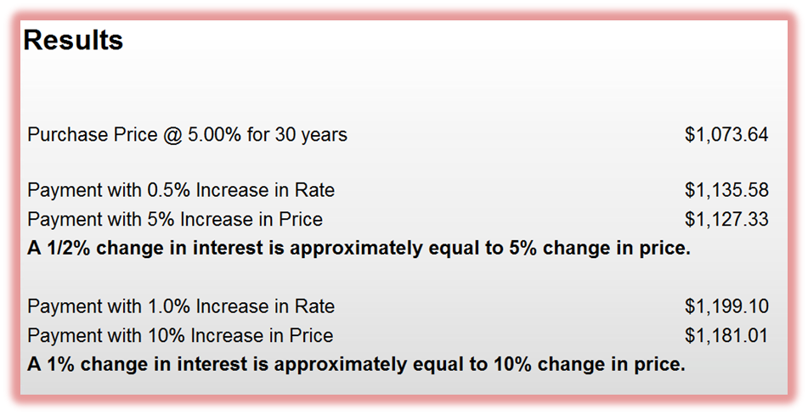
Why does Interest rate matter ?

Slide 15
Loan Process
Find your dream house
Agree on price
Under contract
Earnest Money deposit
Lock your interest Rate- 30-90 days

Slide 16
Inspection / Appraisal
Inspection- You pay ($250-$500)
Appraisal- Collateral- ($350-$450)

Slide 17
Loan Process Continued
Loan processor- Collect & Verify documentation
Submit package to underwriter
Meet additional condition/ documentation
Final loan approval
Closing date

Slide 18
Closing
HUD Statement/Closing statement
Go over number before closing
Photo ID and funds to close- Wire or Cashiers
At Attorneys/Title company office
Take 1-2 hours

Slide 19
Tax Write off
Mortgage Interest on loans upto $1 Million
Interest on Line of Credit upto $100K
Mortgage interest on second home
Points paid for lower rate
Closing cost- Certain Real-estate Taxes

Slide 20
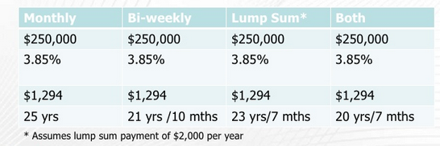
You have to pay it back !

Slide 21
Questions?

