Slide 1
Graduate Real Estate Association at Tepper
(GREAT)

Slide 2
AGENDA
Introduction
Board Bios
Careers
Events
Next Steps

Slide 3
What is GREAT?

Slide 4
Our Goals
GREAT B-PLAN
Networking
Case Competitions
Skills Development

Slide 5
Who we are…

Slide 6
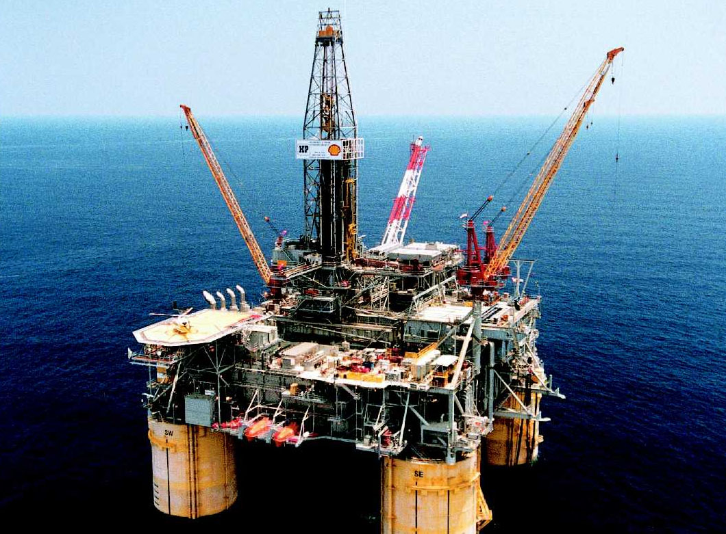
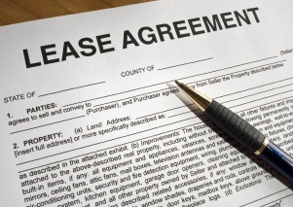
Benjamin Nolte
Marketing
Analyzed and Interpreted over 6000 oil and gas leases
Reverse engineered factional property ownership interest

Slide 7
Michael Zhong
Technology
Consultancy Focus on large scale condos
Operation Strategy Focus on home loan acquisition

Slide 8
Roshy Rajan
Operations
Portfolio Management Focus on high growth residential
Real Estate Entrepreneur Specialized in foreclosures

Slide 9
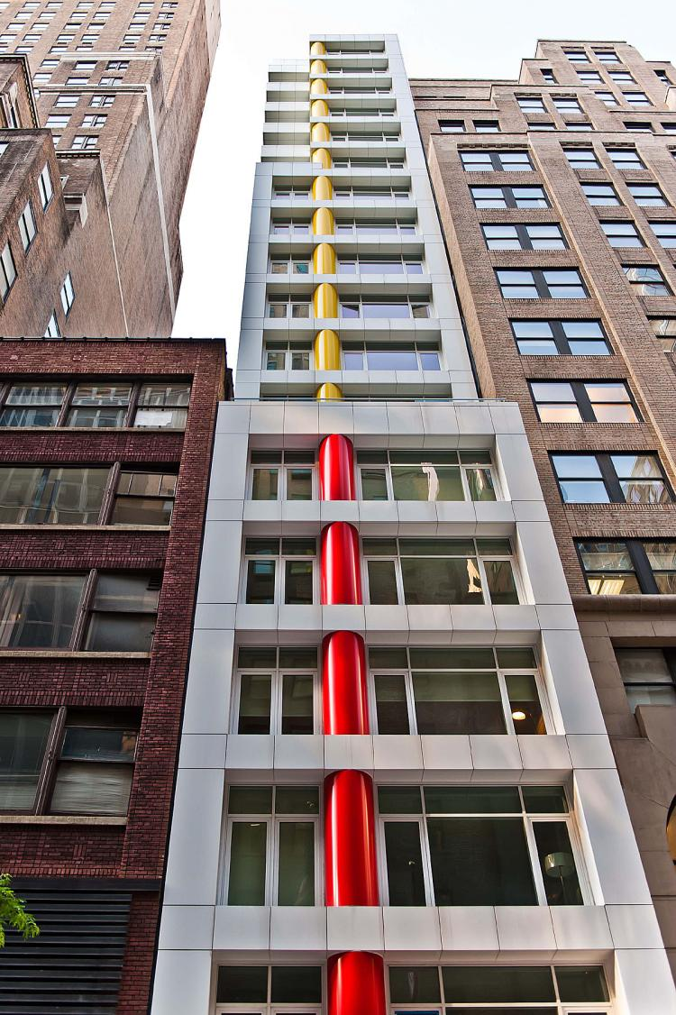
Justin Veach
Treasury
Supervised and managed condominium development
Large scale commercial project management with multiple parties

Slide 10
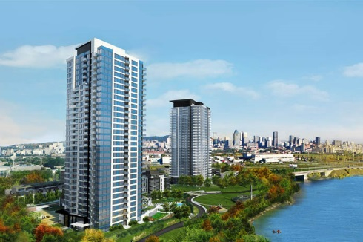
Roger Younan
Alumni Relations
Real Estate Fund Management Focus office and residential
“Green” real estate development and project management

Slide 11
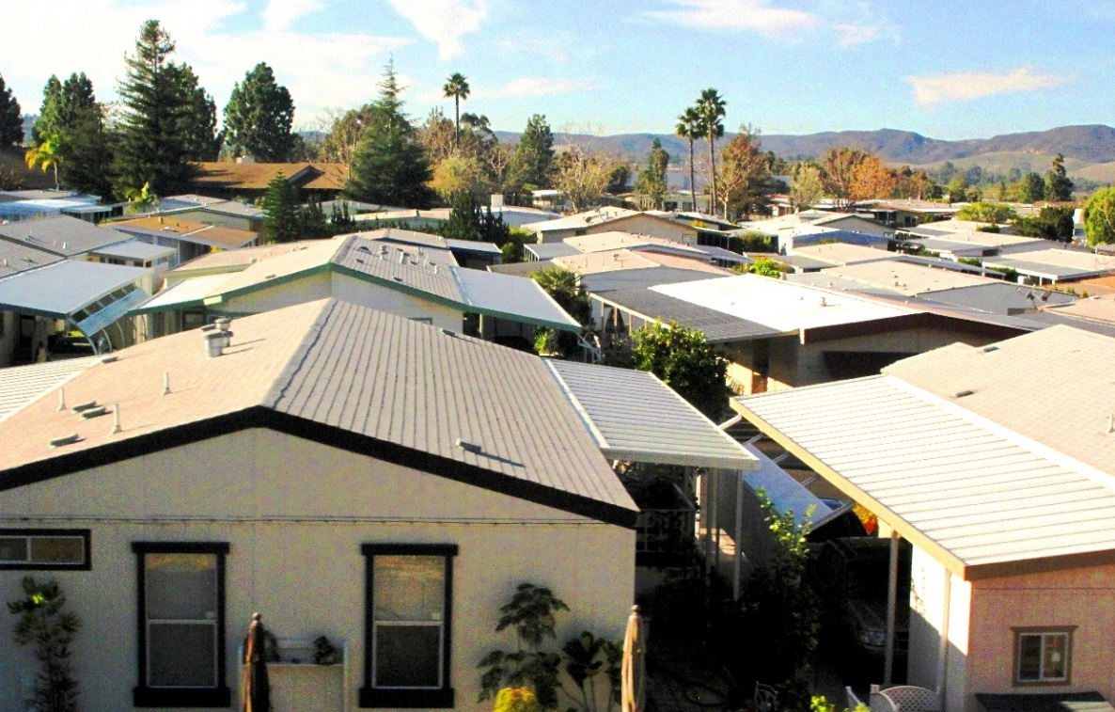
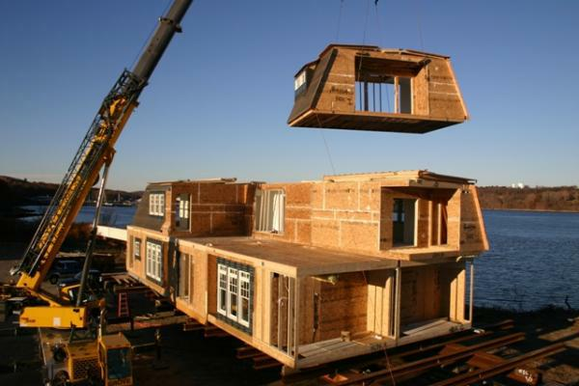
Nima Abar
Vice President
Senior Loan Officer Alternative Investment Products
Financial Underwriting
Managed funding and escrow

Slide 12
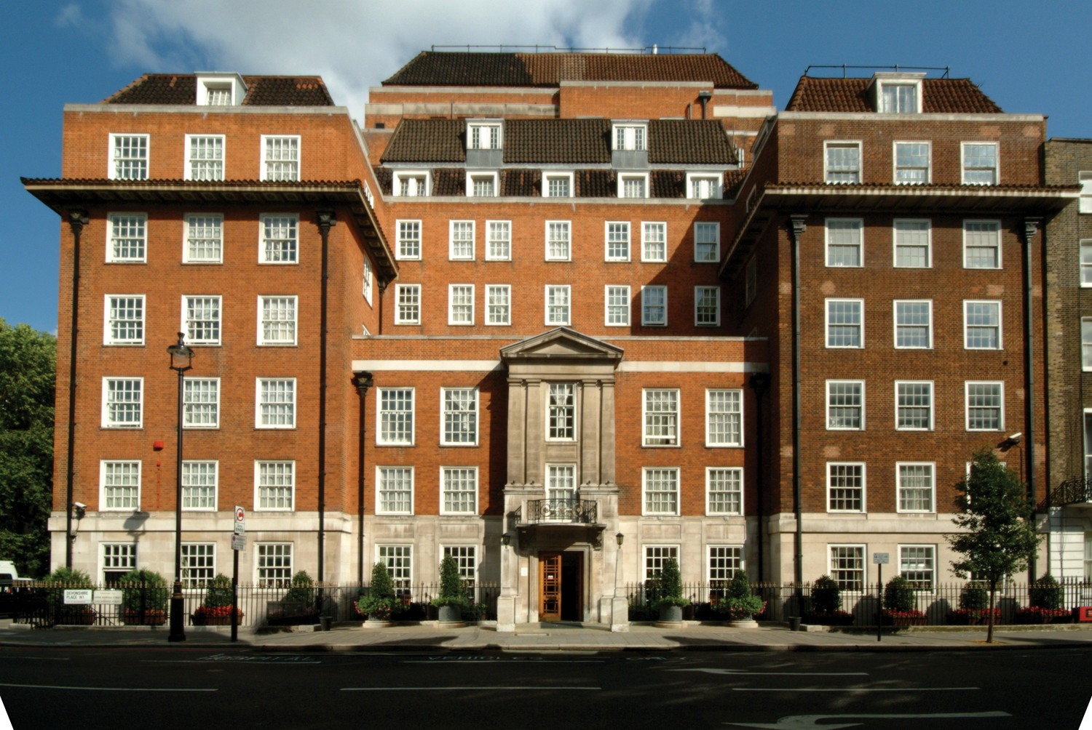
Matthew Fei
President
Real Estate Consulting Healthcare and tertiary assets
Logistics/Office Portfolio Management in Europe

Slide 13
What are your options?

Slide 14
Career Options in Real Estate
COMMERCIAL BROKERAGE
FINANCE
Investment Sales
Leasing Brokerage
Commercial Lending
Investment Banking
Collateralization/IPOs
DEVELOPMENT
EQUITY
Residential/Commercial/Tertiary
Urban Planning
Investment/Acquisitions
Portfolio Management
REITS

Slide 15
What we can offer…

Slide 16
Individually tailored program
ALUMNI PANELS
NEW YORK CITY TREK
On Campus
Collaboration with FlexTime
October 24
Meet with PE, IB & REITS
CONTINUING ED
SOCIAL
Fundamental Valuations
Legal Frameworks
Development Christenings
Beers & Bricks

Slide 17
We need your help
Please notify a GBA representative in your neighborhood

